Slide 1
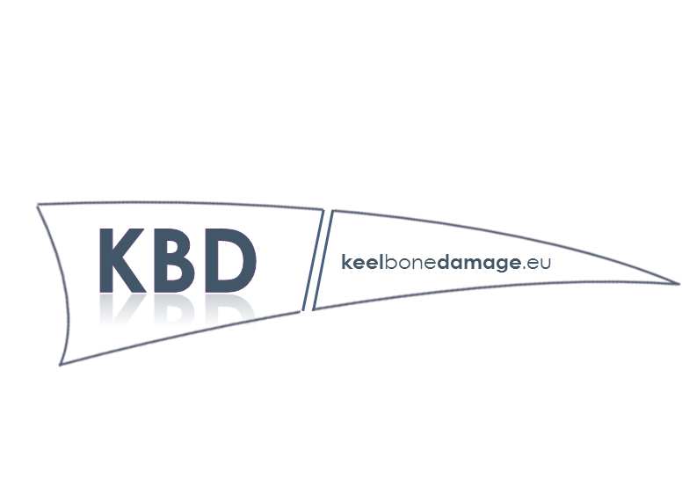
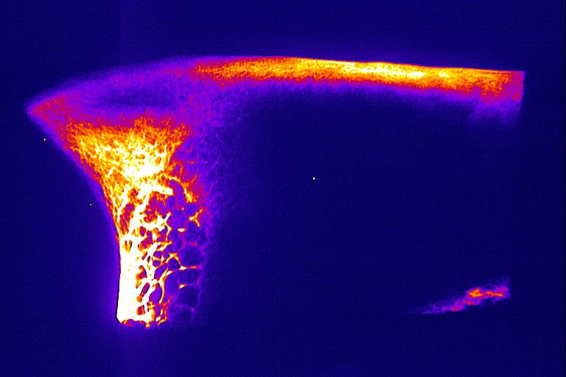
WG1 Measurement
Ian C. Dunn, The Roslin Institute and Royal (Dick) School of Veterinary Studies, University of Edinburgh, Scotland, UK.

Slide 2
Aim
WG1 will serve to coordinate efforts in developing a battery of techniques capable of identifying keel bone damage with a level of accuracy, sensitivity, and detail that meets the needs of the study environment and purpose.
Researchers will share their ongoing efforts in developing methods that can be performed on-farm (e.g., palpation, portable radiography ) as well as more technologically advanced means suited for laboratories that can provide greater qualitative detail (e.g, computed tomography, histology).

Slide 3
Different requirements for different purposes but the ultimate objectives are the same.
To assess incidence of KBD to support efforts to improve nutrition and housing to reduce KBD. This could be in live animals or at post-mortem.
To quantify damage or correlates of damage to improve the genetics of the hens. This would ideally be performed in the living hen, quickly and cheaply.

Slide 4
Keel bone damage causes are multifactorial.
But for genetic and nutritional interventions, using non-keel bone measurements may be effective.
Keel bone damage could be viewed as one symptom of overall deficits in bone quality.

Slide 5
WG1 Objectives
Objective 1) to coordinate efforts in developing a battery of techniques capable of identifying keel bone damage with a level of accuracy, sensitivity, and detail that meets the needs of the study environment and purpose.
Objective 2) to harmonize efforts developed in objective 1 and identify characteristics of damaged bone which can be inferred between methods

Slide 6
WG1 Training and knowledge transfer activities
University of Bern keel bone palpation Training School
August 2017 Bern
June 2018 Antwerp
University of Edinburgh Bone Histology Training School
Edinburgh 2019 Edinburgh

Slide 7
WG 1 Training and knowledge transfer activities
STSM; Many exchanges specifically aimed at getting experience at measuring keel bone damage;
Christin Habig FLI-Roslin
Beryl Eusemann FLI-Roslin
Lazarin Velikov Lazarov -Uof Bern
Mirjana Đukić Stojčić Uof Novi Sad –Uof Bern
Beryl Eusemann FLI-Uof Granada
Elena Armstrong UoNewcastle -Uof Bern
Roslin Institute Mobility award;
Björn Andersson LTZ-Roslin
Maisarah Maidin Roslin-LTZ

Slide 8
WG1 Other activities;
Production of 3 D printable models of keels to train palpators
Sabine Gebhardt U of Bern
Practical phenotype grant
Funded by FFAR Roslin, LTZ, Hyline
Public/Industry engagement
Toscano, M.J. 2017 Keel Bone Fractures: Causes and a way forward. The Ranger, September 2017:97-111
Keel bone research gets a major financial boost, Poultry World, Mar 19, 2018

Slide 9
WG1 Other activities;
Visits on the KBD but not funded directly by COST
ICD to Guelph
SP to Roslin and Granada
ICD to Uppsala
ARN to Uppsala
HMcC & BF to Celle
ICD, BA to Copenhagen
Other visits ………………

Slide 10
WG1 Other activities;
Papers
doi.org/10.1371/journal.pone.0200025 Modeling collisions in laying hens as a tool to identify causative factors for keel bone fractures and means to reduce their occurrence and severity
doi.org/10.3382/ps/pex146 ANIMAL WELL-BEING AND BEHAVIOR Susceptibility to keel bone fractures in laying hens and the role of genetic variation
doi.org/10.1371/journal.pone.0194974 Radiographic examination of keel bone damage in living laying hens of different strains kept in two housing systems
doi.org/10.1016/j.jsb.2017.10.011 Influence of physical activity on tibial bone material properties in laying hens
doi.org/10.1093/jas/sky157 Genome-wide association study for bone strength in laying hens
doi.org/10.3389/fvets.2018.00124 A reliable method to assess keel bone fractures in laying hens from radiographs using a tagged visual analogue scale
doi.org/10.3382/ps/pey326 Assessing keel bone damage in laying hens by palpation: effects of assessor experience on accuracy, inter-rater agreement and intra-rater consistency

Slide 11
WG1 Objectives achieved?
Objective 1) to coordinate efforts in developing a battery of techniques capable of identifying keel bone damage with a level of accuracy, sensitivity, and detail that meets the needs of the study environment and purpose.
Objective 2) to harmonize efforts developed in objective 1 and identify characteristics of damaged bone which can be inferred between methods
Palpation, x-ray and physico-chemical Other techniques appraised
Scoring methods and training schools
Some progress on inference

Slide 12
Future activities;
More STSM; There is a number of exchanges being considered. Need to push forward to complete these.
STSM to test the 3D models
STSM to measure bone physico-chemical parameters in nutrition experiment.
STSM to calculate genetic parameters for novel keel bone phenotypes.
Creative thinking, some of us have a lot of data where we can make discrete projects.
More Training Schools; Is there more novel workshops we can consider?
Radiography! Image analysis. Physical-chemical! Material testing!
Repeat Histology school if there is demand.
Training in palpation, more possibilities.
Working group meeting; Underlying causes of KBD.

Slide 13
Future activities;
Giving an optimistic view.
Practical steps to getting solutions.

