Slide 1
Update on the progress of WG3
Bas Rodenburg, Mirjana Đukić Stojčić

Slide 2
Working group 3
Research objectivs
Identify sources of keel damage and their relationship with the morphology of birds across variable contexts (e.g., age, rearing environment, nutrition, housing/management, genetic...) and relevant interventions based on this understanding.

Slide 3
Completed STSMs KeelBoneDamage 2017/2018 – 2nd Grant period (WG3)
STSM title: Effect of ramps and genetic line on the prevalence of keel bone damage and foot lesions in hens housed in commercial aviaries
Grantee name: Nikki Mackie
Host: Flemish Research Institute for Agricultural, Fisheries and Food (ILVO) Belgium, Frank Tuyttens
STSM title: Effect of perch arrangements in furnished cages on KBD (n°10) STSM Grantee name: Vida Rezar
Host: University of Novi Sad Faculty of Agriculture Department of Animal Science, Mirjana Đukić Stojčić
STSM title: KBD occurrence in different production systems in Greece
Grantee name: Mirjana Đukić Stojčić
Host: Veterinary Research Institute, Hellenic Agricultural Organization-demeter, Dr Evangelia N. Sossidou

Slide 4
STSM title: Identifying causes and solutions of Keel Bone Damage in laying hens
Grantee name: Lazarin Velikov Lazarov
Host: Veterinary Public Health Institute, Animal Welfare Division, Zollikofen, Dr Michael Toscano
STSM title: Identification of fractures at the point of occurrence and comparison of assessment methods
Grantee name: Mirjana Đukić Stojčić
Host: Veterinary Public Health Institute, Animal Welfare Division, Zollikofen, Dr Michael Toscano
STSM title: Keel bone fracture prevalence in productive and non-productive hens.
Grantee name: Beryl Eusemann Host: Alejandro Rodríguez Navarro the University of Granada Spain

Slide 5
STSM title: Effect of ramps and genetic line on the prevalence of keel bone damage and foot lesions in hens housed in commercial aviaries Grantee name: Nikki Mackie Host: Flemish Research Institute for Agricultural, Fisheries and Food (ILVO) Belgium, Frank Tuyttens
The main aim of the study was to determine whether ramps and genetic hybrid influence the prevalence of keel bone or foot damage on farms with aviary systems. Previous works showed that provisions ramps and genetic hybrid can influence keel bone damage and foot pad disorder prevalence. However, the research was experimental and used small groups of birds and has not been replicated on farm level.
The main results were:
The birds with access to ramps have slightly improved keel bone fracture prevalence but the difference is not so apparent as in other studies.
High variability in the study may be due to ramp characteristics that differ between farms and placement of ramps in different locations may have different effects on how the birds move
.Farms were visited at different ages and this will influence the prevalence of keel bone fractures in a flock because fracture score increases with age.
It is the first time movements between tiers within commercial aviary systems have been studied with the aim to determine whether having access to ramps and genetic hybrid affect movement.

Slide 6
STSM title: Effect of perch arrangements in furnished cages on KBD (n°10) STSM Grantee name: Vida Rezar Host: University of Novi Sad Faculty of Agriculture Department of Animal Science, Mirjana Đukić Stojčić
In Serbia, change from the conventional cage system to the alternative systems is still in progress. 90% of producers who have switched to alternative systems opt for enriched cages.
Detailed survey on egg producers and customers had been made, to hear their opinion about KBD or they know what KBD is, and for which production system they will decide when the directive 74 / EC comes into force (on 01.01.2021). We wanted to make a clear picture on how many hens are still in conventional cages, and how many producers already have completed enriched cages, in order to estimate the further development of avian systems for egg production.
Database contacts Serbia
The main goal of our STSM were to evaluate the prevalence of keel bone deformities of laying hens in Serbia
The overall range of keel damage observed in conventional cages were only 1% and in enriched cages without equipment 3%. However, KBD of laying hens in enriched cages were present. In the first week of production 1% KBD in laying hens was 3 observed (22 week old), in the middle of egg production 35% (hens were 45 week old) and at the end of production 43% (hens were 76 week old). On the farm where laying hens were housed in free-range system KBD wasn’t perceived. The same results we were also found on households with different material of perches, usually home-made from the wood, where KBD wasn’t observed

Slide 7
STSM title: KBD occurrence in different production systems in Greece Grantee name: Mirjana Đukić Stojčić Host: Veterinary Research Institute, Hellenic Agricultural Organization-demeter, Dr Evangelia N. Sossidou
Although keel-bone damages have a significant negative impact on welfare in laying hens, the extent of the problems in Greek commercial flocks of layers is still unknown. The purpose of this STSM was to define the occurrence of the keel bone damage (KBD) in live laying hens in different production systems in Greece.
Interested industrial partners in Greece (commercial farms with different production systems) were chosen to cooperate in this study. Each of these farms was chosen to match with others as comparable as possible (regarding hybrid type, rearing period, age of laying hens), and each flock was assessed for keel bone damage and other welfare parameters (foot lesions - hyperkeratosis, dermatitis, bumble feet, comb pecking wounds, skin lesion, claws and feather condition). The internal and external egg quality from two different housing systems was determined as well.
The first investigation showed that KBD were present in all three observed production system in Greece. The average range of keel damage observed in laying hens kept in enriched cages was 23,8%.
More layers with KBD problem was found (42,8%) in free range system.
In floor system KBD was not recorded. Only a few hens had a slight deformity of keel bone.

Slide 8
STSM title: Identification of fractures at the point of occurrence and comparison of assessment methods Grantee name: Mirjana Đukić Stojčić Host: Veterinary Public Health Institute, Animal Welfare Division, Zollikofen, Dr Michael Toscano
The purpose of this STSM was to learn methods and use of radiography, palpation, thermography, and visual examination after dissection, to document the occurrence of KBD (Keel bone damage) immediately following collisions in the dusk/dark period.
As for the results of our experiment, we did not get the results we expected. Our assumption that we will be able to find a chicken with fresh fracture, using radiographs on the first day, was not confirmed. During the experiment, we did not detect fresh fractures immediately after a fall.
We came to the conclusion that the use of thermal cameras in KBD detection is not possible. Feather is a good thermal insulator. The feathering of chickens was different in the breast area, so thermal camera images are not usable and cannot be compared to each other.
Also, a correlation between radiographic and thermal images cannot be established.
We confirmed that keel bone deformities couldn’t be determined with certainty by radiograph analysis, because some deformities of the keel bone can only be confirmed by palpation. Therefore, a combination of palpation and radiograph analysis seems to be necessary to examine the complete extent of keel bone damage.

Slide 9
STSM title: Keel bone fracture prevalence in productive and non-productive hens. Grantee name: Beryl Eusemann Host: Prof. Alejandro Rodríguez Navarro / Universidad de Granada, Departamento Mineralogía y Petrología, Spain
In Celle was had found a significat lower keel bone fracture prevalence in non-productive hens.
In Granada, we analyzed tibiotarsi of both groups and of two different layer lines (a high performing and a low performing line) using thermogravimetric analysis, Fourier-transform infrared spectroscopy, X-ray diffraction, three-point bending test and scanning electron microscopy.
The main results were:
- Comparison of non-productive vs. productive hens:
A greater bone diameter of tibiotarsi in non-productive hens;
Higher bone breaking strength in non-productive hens;
Lower degree of mineralization of cortical bone in non-productive hens;
Higher degree of orientation of hydroxyapatite crystals in productive hens (indicative of increased bone mineral maturity);
Medullary bone present in tibiotarsi of productive but not of non-productive hens.

Slide 10
- Comparison of control (productive) hens of a low (G11) and a high performing line (WLA):
Longer, thicker and heavier tibiotarsi in WLA;
Higher whole bone strength in G11 when corrected for area;
Higher strength of a cortical bone slice in WLA;
Higher degree of mineralization of cortical and medullary bone in G11;
Greater crystallinity of cortical bone mineral and higher degree of carbonate substitution in G11 (indicative of increased bone mineral maturity).

Slide 11
STSM title: Identifying causes and solutions of Keel Bone Damage in laying hens STSM Grantee name: Lazarin Velikov Lazarov Host: Veterinary Public Health Institute, Animal Welfare Division, Zollikofen, Dr Michael Toscano
The purpose of this STSM was to extend my knowledge and practical skills in developing and validating techniques that can diagnose, assess, and distinguish anatomical characteristics of keel damage with a high level of accuracy and consistency across a variety of situations, which match specific needs of the research environment.
The ability of a CaT and HYD to reduce susceptibility to fracture has been tested using an ex vivo protocol developed by Michael Toscano's group.
In this system, collisions of quantifiable energetic loads are performed directly onto the keels of deceased birds allowing the likelihood of fracture to be assessed for respective treatments. Our expectation was that birds receiving a diet characterized by CaT, HYD, or a combination of the two will manifest a reduced risk of fracture which we can model statistically.
The main results were: the studies still to be done?

Slide 12
One STSMs are planned for this GP- linked to WG3:
- Ine Kempen will investigate is keel bone damage assessment can be integrated in on-farm welfare assessment protocols.

Slide 13
Training Schools
The 2nd Keel Bone Damage (KBD) Training School were held on June 14th at the Experimental Poultry Centre in Geel, Belgium, Ine Kempen
- The training school in Geel has been a good thing to raise awareness of the issue and to demonstrate the problem to them in the palpation session with the X-rays
- Target audience is the Benelux poultry industry and members of the COST action.
- The 3nd Keel Bone Damage (KBD) Training School - in Eastern Europe?

Slide 14
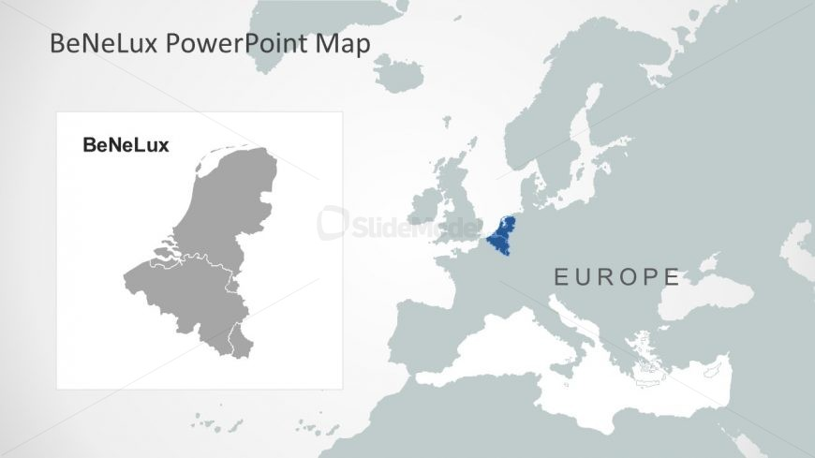
Activeties
Benelux , Middle Europe and Southeast Europe
BeNeLux - Ine Kempen and her team Experimental Poultry Centre,
Belgium - Alternative systems
Database contacts Benelux: list of contacts from research, industry, farmer organisations interested in keel bone cost action topics, covering poultry sector in Benelux
Co-creation of dissemination material: leaflet, business cards, powerpoint template
Co-creation of poster, displayed at Welfare symposium in Ploufragan
Presentation of two topics at research meeting in Bratislava
Co-organisation and co-hosting of stakeholder meeting in Zagreb for the poultry industry
STSM: hosted by Alexandra Jeremiasson from Svenskagg in Sweden- exploring the possibility to involve keel bone assessment in welfare audits
Organisation of the keel bone damage benelux training school
Flemish funding grant (together with ILVO) for research on strategies to prolong the laying hen cycles, focussing also on effect on keel bone damage. Starting at 1/12/2018 and duration of 4 years

Slide 15
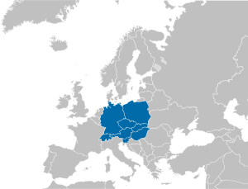
Middle Europe
Veterinary Public Health Institute, Animal Welfare Division, Zollikofen, Dr Michael Toscano
Alternative systems
Funding from:
- industry using Calcium timing in combination with a calcium supplement to improve bone mineral retention and decrease fracture rates
- a US based funder (Egg Industry Center) to investigate variation in rearing (usage of ramps, different aviary structures) in pullet bone health and laying period productivity and fractures
- a US based funder (currently not public) to provide training to North American-based producers as to best non-cage system hen management
*development of leaflets and video material targeting producers to provide practical knowledge of KBF and how best to reduce their occurrence
***following from a COST funded meeting to develop this material

Slide 16
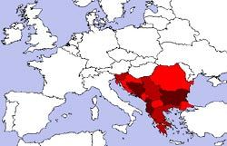
Southeast Europe Balkan region
Evangelia Sossidou Greece, Manja Župan, Lubor Kostal –Slovakia, Lazar lazarov Bulgaria,Zlatko Janječić - Croatia, Renata Relić and Mirjana Đukić Stojčić- Serbia
(There are still many inactive members)
-Situation in poultry production is similar, regardless of whether the country is a EU member (Directive 1999/74/EC is effective) or not.
Most laying hens are kept in cages
So far completed
The extent of the KBD in commercial flocks of layers were unknown even among scientific and professional community - now is known (No similar research was conducted in our countries untill KBD Cost Action)
Countries developed a database of such farms
Problem is identified in different systems (Enriched cages, less aviary)
Needs to be done
- An inventory of current research and researchers
- Investigation of possibilities for new collaborations – by connecting existing national projects, and by expanding collaborations
Looking for new projects funded by EU(housing, environment, nutrition, genetic)
Development of leaflets and video material
Develop specific platforms and exchanges to allow results and methodologies to be transferred with ease between participants to enhance innovation.

Slide 17
Dissemination and publication
Dr Evangelia N. Sossidou - Disseminated the project with an oral presentation at the 6th Mediterranean Poultry Summit, Torino 2018.
Beryl Eusemann - Abstract to the 45th European Calcified Tissue Society Congress which takes place in Valencia from 26th to 29th May 2018.
Abstract to the 15th European Poultry Conference which takes place in Dubrovnik from 17th to 21st September 2018.
Mirjana Đukić Stojčić - One paper published in Serbian Journal of Agricultural Sciences “Biotechnology in Animal Husbandry”
- One paper published in Serbian Journal of Poultry Sciences Živinarstvo
Abstract to the 15th European Poultry Conference (Dubrovnik, Croatia, September 2018)
- One paper will published on meeting of poultry production “Savetovanje živinara” (ex Yugoslavian countries)
- Oral presentation - at the regional meeting of poultry production “Savetovanje živinara” (ex Yugoslavian countries)

